Slide 1

Advancing Nano-CT Image Analysis in Battery Research through Image Fusion Diffusion Models
Master’s Thesis Defence
Notes:
Good morning and welcome. My name is Utku and I’ d like to present my master’ s thesis titled as Advancing Nano-CT Image analysis in Battery Research through Image Fusion Diffusion Models.

Slide 2
Motivation
Initial Motivation
Initial Solution
Final Proposal
Nano-CT
Convert to image processing tasks
Limited image resolution
Deep Learning
DDMs
Data Scarcity
EnDFM
Interpretable SR images
High computational cost
Lack of explainability
Computational efficiency
Reproducible & scalable
Hastened imaging process
Long durations
Scarce information
Notes:
This study is first formed as a software-based solution addressing the limitations encountered in lab-based nanotomography such as ... . We approached the problems as image processing tasks. However, DL-based solutions pointed out more problems like ... , leading this study to shape further. The proposed image pipeline, EnDFM is an efficient, reproducible and scalable solution that is capable of reconstructing interpretable multimodal images in seconds.

Slide 3
Agenda
Proposed Method
Dataset
Results
Discussion
Conclusions
Improvements
1
2
3
4
5
6
Notes:
The presentation is divided into 6 chapters.

Slide 4
Agenda
Proposed Method
Dataset
Results
Discussion
Conclusions
Improvements
1
2
3
4
5
6
Notes:
I would like to begin with the details of the EnDFM.

Slide 5
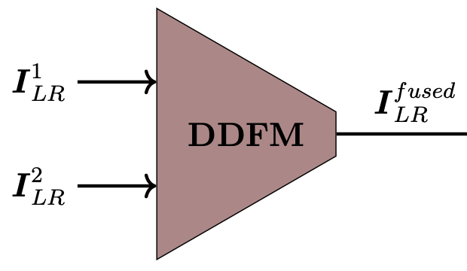
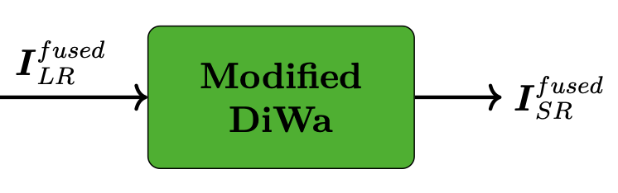
Proposed Method
EnDFM: Enhancing Diffusion Fusion Model
DDFM: Denoising Diffusion Fusion Model
Performs Multi-Modal Image Fusion (MMIF)
Unconditional DDPM* + an EM** step (conditional DDPM)
Pre-trained checkpoints
Modified DiWa: Diffusion Wavelet
Performs Single-Image Super-Resolution (SISR)
Discrete Wavelet Transform (DWT) + Conditional DDPM
Trained from scratch
(*) Denoising Diffusion Probabilistic Model
(**) Expectation-Maximization
Notes:
EnDFM is an abbreviation derived from ... .
It consists of two main submodules. DDFM is a diffusion-based MMIF module. It is a combination of an unconditional DDPM and a step of EM algorithm. This module is only used in inference mode.
The second submodule is adapted from a SISR model called DiWa. This module is based on Conditional DDPMs and operates in wavelet domain. Before mentioning the datasets the model trained and tested, I would like to introduce the modifications made on the base model.

Slide 6
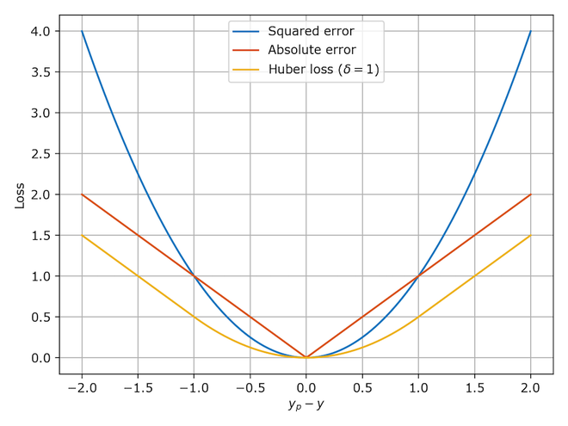
Proposed Method
Modified DiWa:
Loss function: Huber loss
Notes:
The first modification is utilizing a more complex loss function called Huber loss. This loss function acts as the combination of Mean Absolute and Mean Square errors with respect to the hyperparameter, delta. Depending on whether the error value is smaller or larger than delta, the function acts like MSE or MAE function, respectively. The reason of this modification is to have the differentiability property of l2 norm and not penalizing the large deviations more.

Slide 7
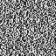
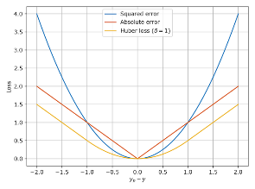
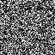
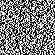
Proposed Method
Modified DiWa:
Loss function: Huber loss
Auxillary loss term: Encoder loss
LR _enc
Diff
HR _enc
Notes:
The second modification is introducing an auxillary loss term called the encoder loss. This loss calculates the distance between the most densest encodings of the input and the ground truth images.
The resulted error matrix is then fed into the same loss function mentioned before. We aimed to make the model converge better and be more accurate while doing so.

Slide 8
Agenda
Proposed Method
Dataset
Results
Discussion
Conclusions
Improvements
1
2
3
4
5
6
Notes:
The second chapter is the datasets.

Slide 9
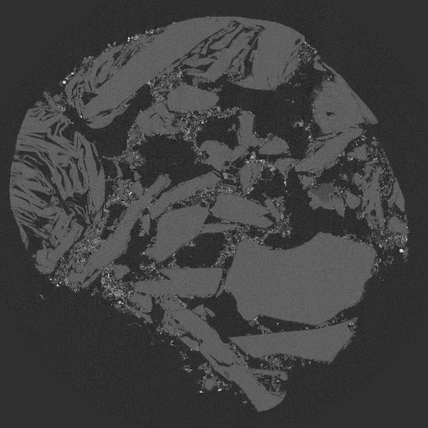
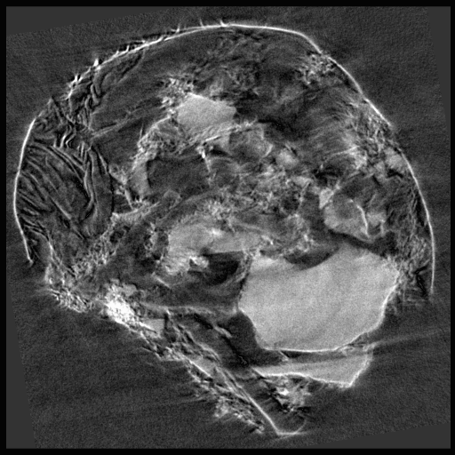
Dataset
Two pristine and cycled graphite-silicon composite negative lithium-ion battery (LIB) electrodes*
Two modalities for each electrode
Ptychographic X-ray Computed Tomography (PXCT)
Transmission X-ray Tomographic Microscopy (TXTM)
^{(*)} Ptychographic X-ray tomography data of two graphite-silicon composite negative lithium-ion battery electrodes
Notes:
The model is trained on a LIB dataset of two electrodes in different states. Each electrode has two monomodal scannings, Ptychographic XCT (on the left) and Transmission XTM (on the right).

Slide 10
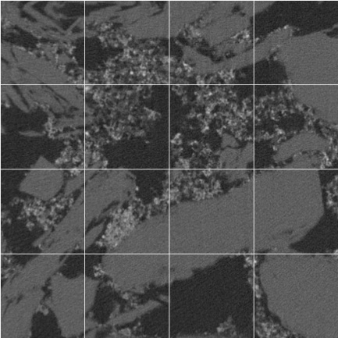
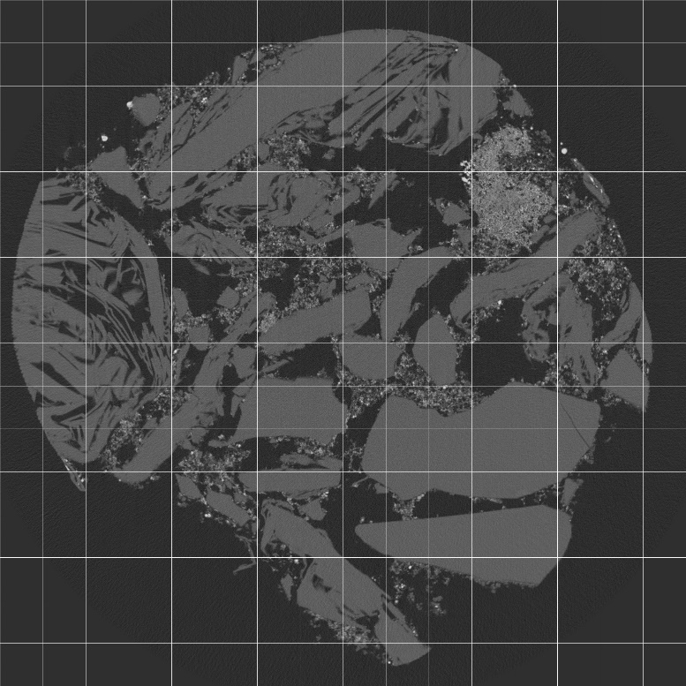
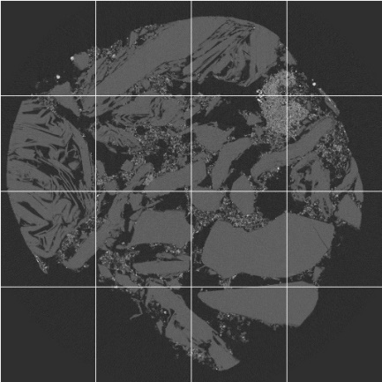
Data Pile Creation
Cropped
Original image
Downsampled
{2048, 2048}
{512, 512}
Notes:
From the raw images of size 2048 by 2048, a data pile is created for further purposes. The data pile consists of patches cropped from the original images and downscaled full images. 5% of the resulting images are reserved for the first test dataset.
Some of the full-sized images are undergone modifications like denoising and fusion with respect to the likelihoods defined beforehand.

Slide 11
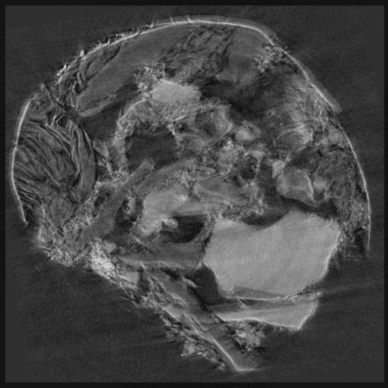
Dataset (DDFM)
PXCT pristine (raw)
TXTM pristine (raw)
Fused pristine
Notes:
The first modification is MMIF. Here you are seeing two monomodal and a fused scanning.

Slide 12
Dataset (DDFM)
PXCT pristine (raw)
TXTM pristine (raw)
Fused pristine
Notes:
Edges and corners are well defined in PXCT image whereas TXTM image offers higher contrast regions, making it suitable for material segmentation. The fused images on the other hand aim to represent the most prominent aspects of the given modalities in a single image.

Slide 13
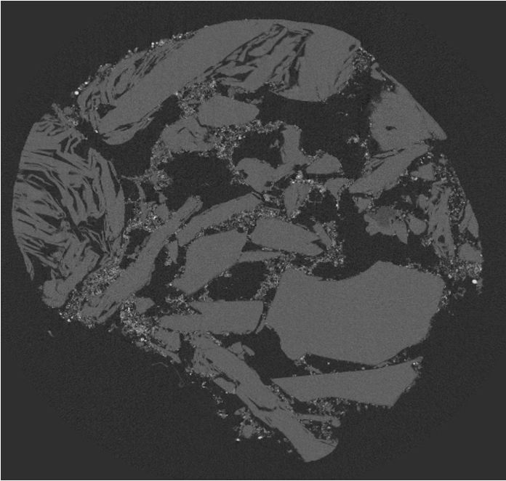
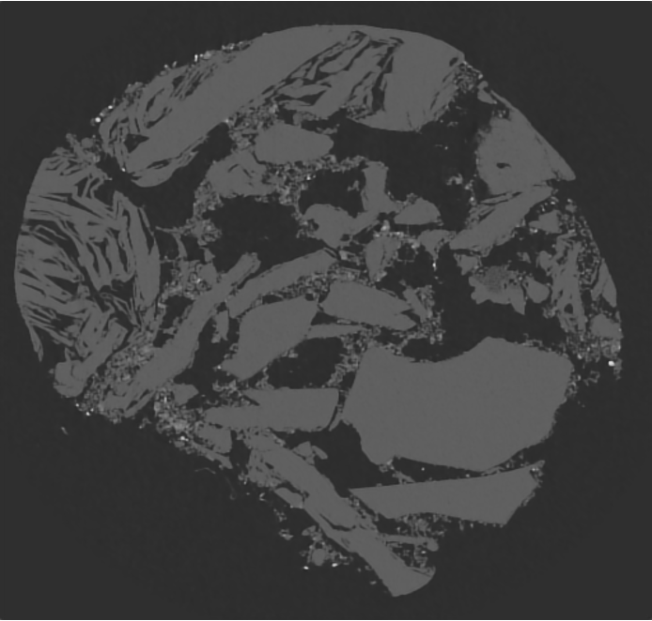
Dataset (N2F)
N2F: Noise2Fast → Blind image denoising
PXCT pristine (raw)
PXCT pristine (denoised)
Notes:
The other modification is image denoising. For this purpose, a self-supervised image denoising module called N2F is utilized.

Slide 14
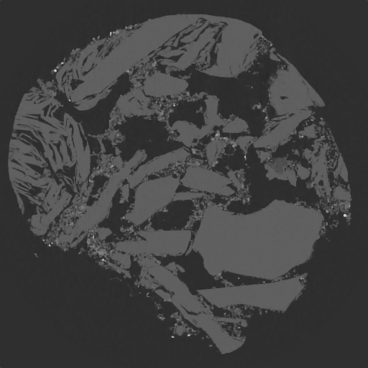
Dataset (N2F)
N2F: Noise2Fast → Blind image denoising
PXCT pristine (raw)
PXCT pristine (denoised)
Notes:
Denoising is applied to cope with the imaging artifacts. The raw image has a rough surface and sometimes those details bias the model. The image on the right has a smoother surface with an infinitesimal loss of resolution.

Slide 15

Dataset (N2F)
TXTM pristine (raw)
TXTM pristine (denoised)

Slide 16
Dataset (N2F)
TXTM pristine (raw)
TXTM pristine (denoised)

Slide 17

Dataset (N2F + DDFM)
Fused pristine (raw)
Fused pristine (denoised)
Notes:
Some images are undergone the both modifications.

Slide 18
Dataset (N2F + DDFM)
Fused pristine (raw)
Fused pristine (denoised)
Notes:
Although the difference is not significant, fusion of denoised samples led a bit higher contrast than plain image fusion.

Slide 19
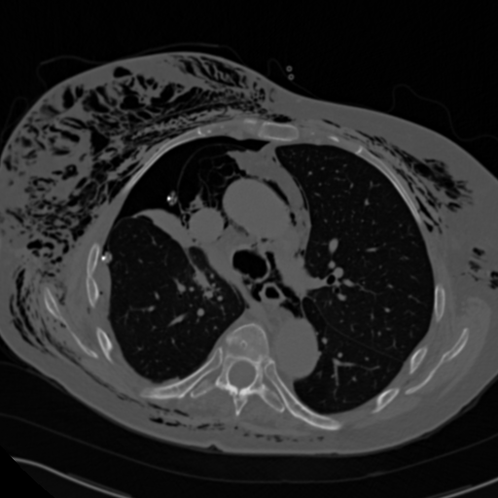
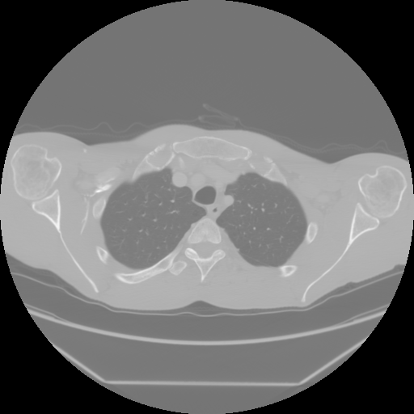
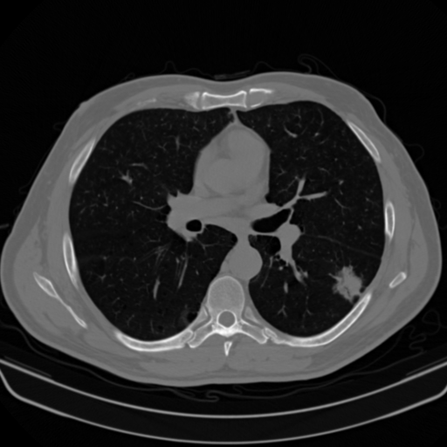
Dataset (Medical CT)
A second test dataset* of thoracic axial CT scans of patients is used to better demonstrate the generalization ability of the model.
^{(*)} The Cancer Genome Atlas - Lung Adenocarcinoma Collection
Notes:
A second dataset of a completely different domain is used to show the generalization ability of the model better. This dataset includes axial CT scans of human thoraxes and shows the similar characteristics with the original dataset in terms of details and contrast.

Slide 20
Agenda
Proposed Method
Dataset
Results
Discussion
Conclusions
Improvements
1
2
3
4
5
6
Notes:
The next chapter is the results obtained. But first, I’ d like to mention an important step of training the model: Hyperparameter optimization.

Slide 21
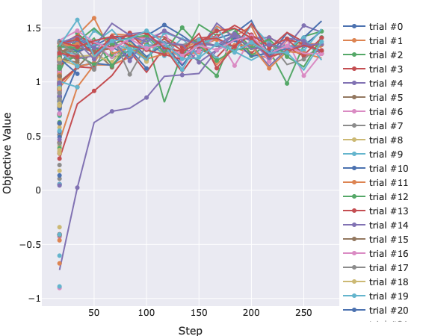
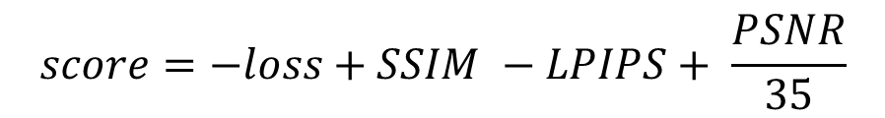
Results (Hyperparameter optimization)
$$score=−loss+SSIM −LPIPS+ \frac{PSNR}{35}$$
Notes:
During this step, a script tries to maximize the given objective value in a finite number of trials. We adopted pruning strategy for efficiency.

Slide 22
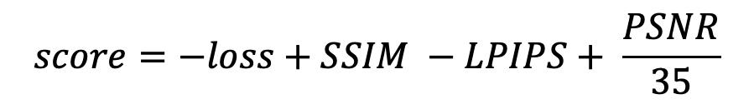
Results (Hyperparameter optimization)
$$score=−loss+SSIM −LPIPS+ \frac{PSNR}{35}$$
Structure Similarity Index Measurement (SSIM)
0
1
Learned Perceptual Image Patch Similarity (LPIPS)
0
1
Peak Signal-to-Noise Ratio (PSNR)
0
∞
Loss
0
∞
Notes:
The objective function is defined as the linear combination of training loss and the evaluation metrics used in this study. The ranges of metrics are given in the right where the desired valuesare given next to the green color. The first two metrics, LPIPS and SSIM represent the human perception whereas PSNR represents the image quality.

Slide 23
Results (Hyperparameter optimization)
$$score=−loss+SSIM −LPIPS+ \frac{PSNR}{35}$$
Notes:
This process results the relative importance of the hyperparameters on the score function along with their optimal values. As could be seen on the right, the most important parameters are learning rate and number of residual blocks.

Slide 24

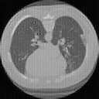
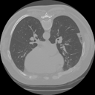

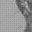

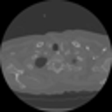


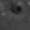
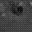
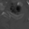
Results (Medical CT)
{128,128}
PSNR: 27.74 dB
SSIM: 0.69
LPIPS: 0.05
PSNR: 29.74 dB
SSIM: 0.625
LPIPS: 0.078
LR
SR
HR
Notes:
The model resulted feasible results in Medical dataset, although there are visible point-like artifacts in the reconstructed images.

Slide 25
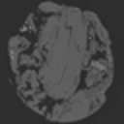





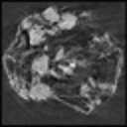
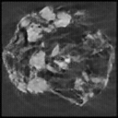

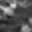
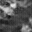
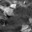
Results (LIB-raw)
{128,128}
PXCT
PSNR: 29.41 dB
SSIM: 0.694
LPIPS: 0.043
TXTM
PSNR: 27.90 dB
SSIM: 0.86
LPIPS: 0.05
LR
SR
HR
Notes:
Similarly, the artifacts persist in LIB dataset.

Slide 26


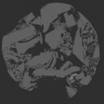

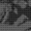


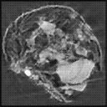

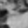
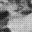
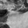
Results (LIB-N2F)
{128,128}
PXCT
PSNR: 28.25 dB
SSIM: 0.682
LPIPS: 0.06
TXTM
PSNR: 22.90 dB
SSIM: 0.625
LPIPS: 0.041
LR
SR
HR
Notes:
Compared to the raw images, denoised images didn’ t result better.

Slide 27
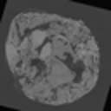





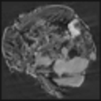
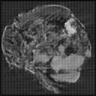

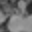
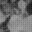
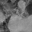
Results (LIB-DDFM)
{128,128}
DDFM
PSNR: 29.70 dB
SSIM: 0.76
LPIPS: 0.022
N2F + DDFM
PSNR: 27.53 dB
SSIM: 0.75
LPIPS: 0.047
LR
SR
HR
Notes:
However, the model performed better on the fused images considering SSIM.

Slide 28
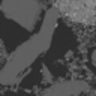
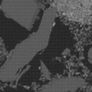

Results (LIB-patch)
{128,128}
PSNR: 27.90 dB
SSIM: 0.86
LPIPS: 0.049
LR
SR
HR
Notes:
The most surprising aspect of the model is its’ relatively superior performance on patch images. However, the artifacts are still visible.

Slide 29
Agenda
Proposed Method
Dataset
Results
Discussion
Conclusions
Improvements
1
2
3
4
5
6
Notes:
To discuss our findings…

Slide 30
Discussion – Key Findings
A lightweight model for enhancing tasks
Satisfactory results based on human perception (SSIM and LPIPS)
Very suitable for patch-based reconstruction
The first study focused on enhancing fused images.
Notes:
This study resulted a lightweight model producing satisfactory results for enhanching tasks. Apart from full image reconstruction, the model proved to be used for patch-based reconstruction , too. To our knowledge, this is the first study aims to combine MMIF and SISR.

Slide 31
Discussion – Limitations
Model complexity
Data scarcity
Hyperparameter optimization
Lack of previous studies
Notes:
However, we encountered a couple of limitations. A shallower module is used to satisfy the computational efficiency by compromising the resolution. The training dataset lacks of diversity by consisting of only two sample groups. Superficial evaluation metrics and roughly formulated objective function are the next limitations on our list. Since diffusion is a relatively newer field of research in SISR task, the literature was figuratively ‘barren’.

Slide 32
Agenda
Proposed Method
Dataset
Results
Discussion
Conclusions
Improvements
1
2
3
4
5
6
Notes:
To conclude our study,

Slide 33
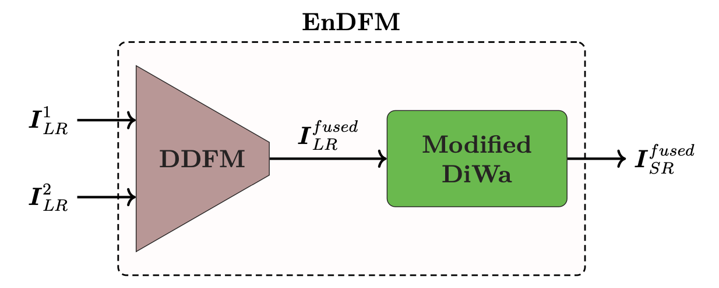
Conclusions
EnDFM: Enhancing Diffusion Fusion Model
Novel generative method
Successfully enhances battery NanoXCT
10 s/image
Notes:
a novel generative method capable of performing given image fusion and super resolution tasks in approximately 10 seconds is proposed. This pipeline could be used as either a standalone module for the existing samples or a preprocessing step for segmentation or classification pipelines. Although the success of the proposal is limited for the time being, the proposal offers a wide room for improvements by being reproducible and scalable as aimed in the beginning. Hence this brings us to the last chapter,…

Slide 34
Agenda
Proposed Method
Dataset
Results
Discussion
Conclusions
Improvements
1
2
3
4
5
6
Notes:
Improvements

Slide 35
Improvements
Limitations include dataset scarcity and room for improved metrics and optimization.
Future improvements:
Self-supervised learning
Enhanced evaluation metrics
Denser residual blocks
Model unification for increased performance
Notes:
The performance of the proposed method could be increased by .. Introducing self-supervised learning
Using more realistic evaluation metrics and a more accurate objective function
Changing present residual blocks with denser ones
Unifying the submodules
After submitting the thesis, I focused on the third option…

Slide 36
Improvements
Limitations include dataset scarcity and room for improved metrics and optimization.
Future improvements:
Self-supervised learning
Enhanced evaluation metrics
Denser residual blocks
Model unification for increased performance
Notes:
Denser residual blocks

Slide 37


Improvements
Denser Residual Blocks
Old
New
^{(*)}If input and output dimensions are not matching, the residual connections include another convolutional layer.
Notes:
The original structure of the residual blocks is given on the left whereas a new architecture inspired from Residual Dense Bridges with an additional convolutional layer is given on the right.

Slide 38

Improvements – Results (Medical CT)
{128,128}
Old
PSNR: 27.74 dB
SSIM: 0.69
LPIPS: 0.05
New
PSNR: 31.58 dB
SSIM: 0.858
LPIPS: 0.039
LR
SR
HR
Notes:
There are both qualitative and quantitative enhancements, although some inferior artifacts could be seen still.

Slide 39

Improvements – Results (LIB-PXCT raw)
{128,128}
Old
PSNR: 29.41 dB
SSIM: 0.694
LPIPS: 0.043
New
PSNR: 42.47 dB
SSIM: 0.980
LPIPS: 0.0027
LR
SR
HR
Notes:
For the LIB sample, improvements are gigantic in terms of all metrics adopted. Additionaly, the existing artifacts seem to be dealt with with the new architecture.

Slide 40

Improvements – Results (LIB-TXTM N2F)
{128,128}
Old
PSNR: 22.90 dB
SSIM: 0.625
LPIPS: 0.041
New
PSNR: 40.43 dB
SSIM: 0.986
LPIPS: 0.0011
LR
SR
HR
Notes:
Similar to the previous sample, reconstruction is almost perfected. Compared to the prior sample, model’ s performance s not affected significanly regarding the modality and the denoising operation.

Slide 41

Improvements – Results (LIB-DDFM N2F)
{128,128}
PSNR: 27.53 dB
SSIM: 0.75
LPIPS: 0.047
Old
PSNR: 40.86 dB
SSIM: 0.984
LPIPS: 0.0021
New
LR
SR
HR
Notes:
Yet again, the model performed as expected with the fusion of denoised samples.

Slide 42

Improvements – Results (LIB-patch)
{128,128}
PSNR: 27.90 dB
SSIM: 0.86
LPIPS: 0.049
Old
New
PSNR: 31.53 dB
SSIM: 0.89
LPIPS: 0.034
LR
SR
HR
Notes:
The artifacts are gone, but the texture details are smoothed compared to the ground truth. Therefore, the improvement in the metrics are not significant.

Slide 43
Improvements – Quantitative Analysis
+42.5%
~ +700%
+31.7%
-69.9%
Notes:
With the addition of a new convolutional layer, the total number of parameters is increased by 42.5 percent. However, average psnr over the test data increased sevenfold.
The average ssim increased by 31.7 percent ..
And the average lpips dropped by almost 70 percent. Under the light of the new findings, the trade-off between the model complexity and the model performance is quite feasbile.

Slide 44
Acknowledgements
The study is conducted with computing resources granted by RWTH Aachen University under project thes1708.
Notes:
All resources used in this study were granted by RWTH Aachen University.

Slide 45
Advancing Nano-CT Image Analysis in Battery Research through Image Fusion Diffusion Models
Master’s Thesis Defence
Notes:
Thank you for listening.

Slide 46

Modified DiWa (Diffusion)
LR
DWSR
DWSR: Deep Wavelet Prediction for Image Super-Resolution
Acts as an initial predictor
Enhances the low-frequency components of the image
SR

Slide 47


Modified DiWa (Training - Sampling)
Training scheme
Sampling scheme
Notes:
Highlight the encoder and encoder loss -> maybe visualize it

Slide 48


Dataset (Patch)
Patch PXCT pristine (raw)
Patch PXCT pristine (denoised)

Slide 49


Results (Hyperparameter optimization)
Hyperparameter objective function:
$$score=SSIM −LPIPS+ \frac{PSNR}{35}$$
Hyperparameters are chosen accordingly.
Learning rate
Residual blocks
Huber delta
Encoder loss weight
Dropout
Attention resolution
Image size
$$2×{10}^{−5}$$
$$2$$
$$1.3$$
$$0$$
$$0.3$$
$$\left[16\right]$$
$$512$$

